Slide 1
CHAPTER 4 research design

Slide 2
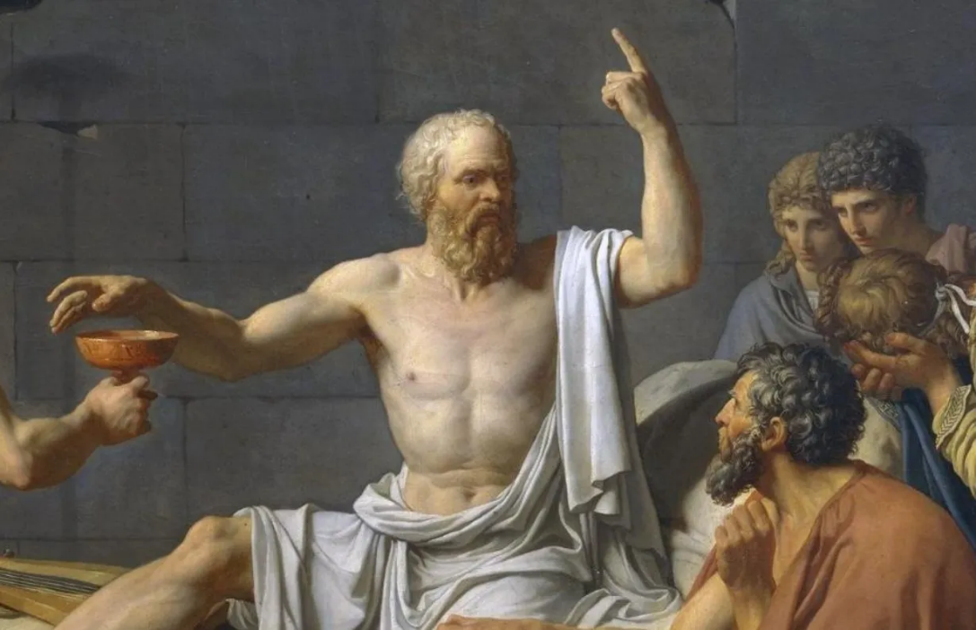
The Scientific Approach
All scientists use the empirical method
  Empirical Method == Using observation or experiments to reach a conclusion.
  Opposite of speculative or exclusively reason-based approaches (like philosophy)
RESEARCH!

Slide 3
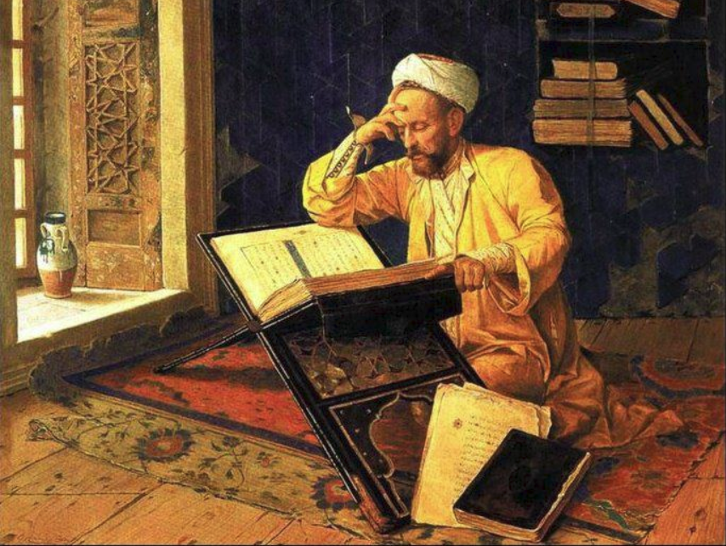

What is research?
The investigation and study of materials and sources
Why? Establish facts, reach new conclusions

Slide 4
Three Purposes of Research
Exploration:
  To satisfy the researcher’s curiosity and desire for better understanding
  To test the feasibility of undertaking a more extensive study
  To develop the methods to be employed in any subsequent study

Slide 5
Three Purposes of Research
Description:
  Describe situations and events through scientific observation
  How do things work? What are the processes involved?
  “Observe and report”

Slide 6
Three Purposes of Research
Explanation:
  Descriptive studies answer questions of what, where, when, and how
  Explanatory studies answer questions of why

Slide 7
Two Types of Research (1)
Basic: Research that answers fundamental questions about phenomena

Slide 8
Two Types of Research (2)
Basic: Research that answers fundamental questions about phenomena
Applied: Research that investigates issues that have direct implications for a specific problem

Slide 9
Two Types of Research (3)
BASIC or APPLIED?
  A study into the different kinds of motivation?
    Basic! Why?
  Developing a test to measure intelligence?
    Applied! Why?
  Researching different types of memory strategies?
    Basic (but maybe both?)

Slide 10
Getting Started: The Research Process
The first steps of the research process:
  Step 1: find a research idea.
    Identify a general topic that interests you.
    Explore previous research in that topic to develop a research idea or question.

Slide 11
Starting the Research Process
What are possible sources?
  Personal interests and curiosities
    Pick a topic about which you want to learn more.
  Casual observation
    Behavior of people or animals may generate a general research topic.

Slide 12
Getting Started: Making the hypothesis
Step 2: form a hypothesis.
Hypothesis = Testable prediction derived from theory
Must be falsifiable!
  Can find evidence for or against!

Slide 13
Reminder on theories vs hypotheses!
A scientific theory is a set of principles or claims intended to offer some description or explanation of a phenomenon
Theory = broad!
Hypothesis = specific and testable
Theory → Hypothesis

Slide 14
Using a Hypothesis to Create a Research Study
  Step 3: specify how the variables will be defined and measured.
    Operationalization!
  What are you measuring? How will you go about it?

Slide 15
Using a Hypothesis to Create a Research Study
Step 4: Figure out who will take your study
Key questions:
  Who is your sample?
  Where will you get them from?
  What will you make them do?

Slide 16
Units of Analysis
Aggregates versus Individuals
  Individuals
    Most common unit of analysis in psychology!
  Groups
  Organizations
  Social Interactions

Slide 17
Conducting research
Step 5: Collect Data/Analyze results
Is there a relationship?
  Yes – time to write! (share findings w/ other researchers)
  No – time to revise! (but maybe also still write…)
    Problem w/ theory?
    Problem w/ operationalization?

Slide 18
Types of Research Designs
Direction Observation/Case Studies
Correlational Studies
Experimental (most common)
More control!

Slide 19
Observational Designs
Systematic observation:
  “Observe and report”
Researcher identifies a behavior of interest
  Watches to see when it occurs!
  Least “scientific” approach... Not controlling for anything

Slide 20
Observation
Naturalistic Observation:
  Traditional observation – researcher stakes out an area and watches for a certain behavior
  Example: How do children react to their first day of school?
    Researcher might watch kids as they are separated from their mother

Slide 21
Observation
  Structured observation
    Researchers create a situation likely to result in the type of behavior in which they are interested
      Can be lab-based or field-based
    Example: Stanford Marshmallow Study

Slide 22
Observation
Ethical issues w/ observation:
  Consent! Participants have rights and typically must provide informed consent before they can participate
  But providing informed consent would ruin observational studies….
  Participants in observational studies often don’t know they are being watched and might act differently if they knew

Slide 23
Case studies
Focus on one individual or a specific group
When to use:
  Document natural occurrences that would be unethical to reproduce!
  Examples: Accidents, disorders, etc.

Slide 24
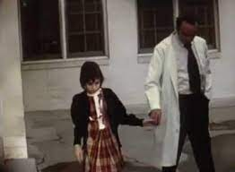
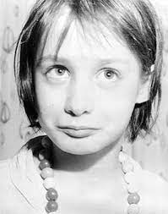
Case study Example
Genie Wiley
In 1970 was admitted to a children’s hospital in Los Angeles at the age of 13
Spent the majority of her life (from the age of 2 onwards) strapped to a potty chair and locked away in a closet
The only human contact she had was with her mother
Outcome: Delayed language development, suggests a “critical period” for learning language

Slide 25
Case Studies
Weakness
  Can’t determine cause/effect
  Sample size too small to determine relationship
    Was something a fluke? Would it replicate?

Slide 26
Correlational Studies
How does “X” relate to “Y”?
  Looks for patterns between two variables
  Example: Relationship between ACT scores and GPA?
Can tell us if a relationship exists but can’t determine cause/effect!
  Does “X” cause “Y”?
  Or does “Y” cause “X”?

Slide 27
Correlational Studies
The strength of association is calculated as a correlation coefficient (-1.0 - +1.0)
  Pearson’s r
  Higher numbers == stronger correlations, negative/positive == the direction

Slide 28
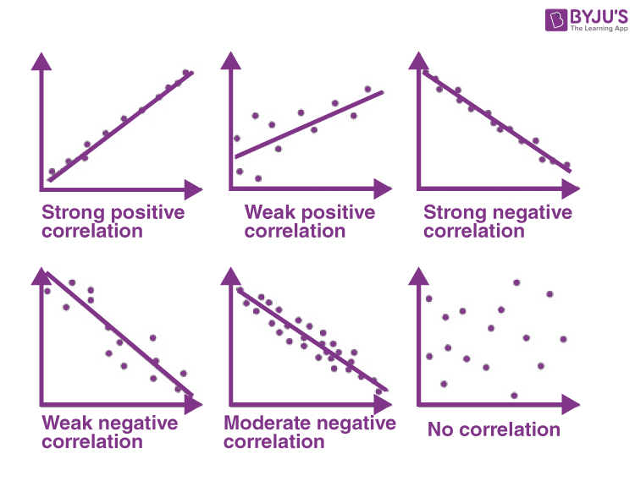
Correlational Studies
r = .99
r = .30
r = -.99
r = -.0
r = -.30
r = -.75

Slide 29
Correlation ≠ Causation
“Third Variable” Problem
  X and Y may simply share a common cause, a third variable (Z)
  Thus, the correlation would be “spurious”
    Correlations can at times appear random or have no explanation for their occurrence

Slide 30
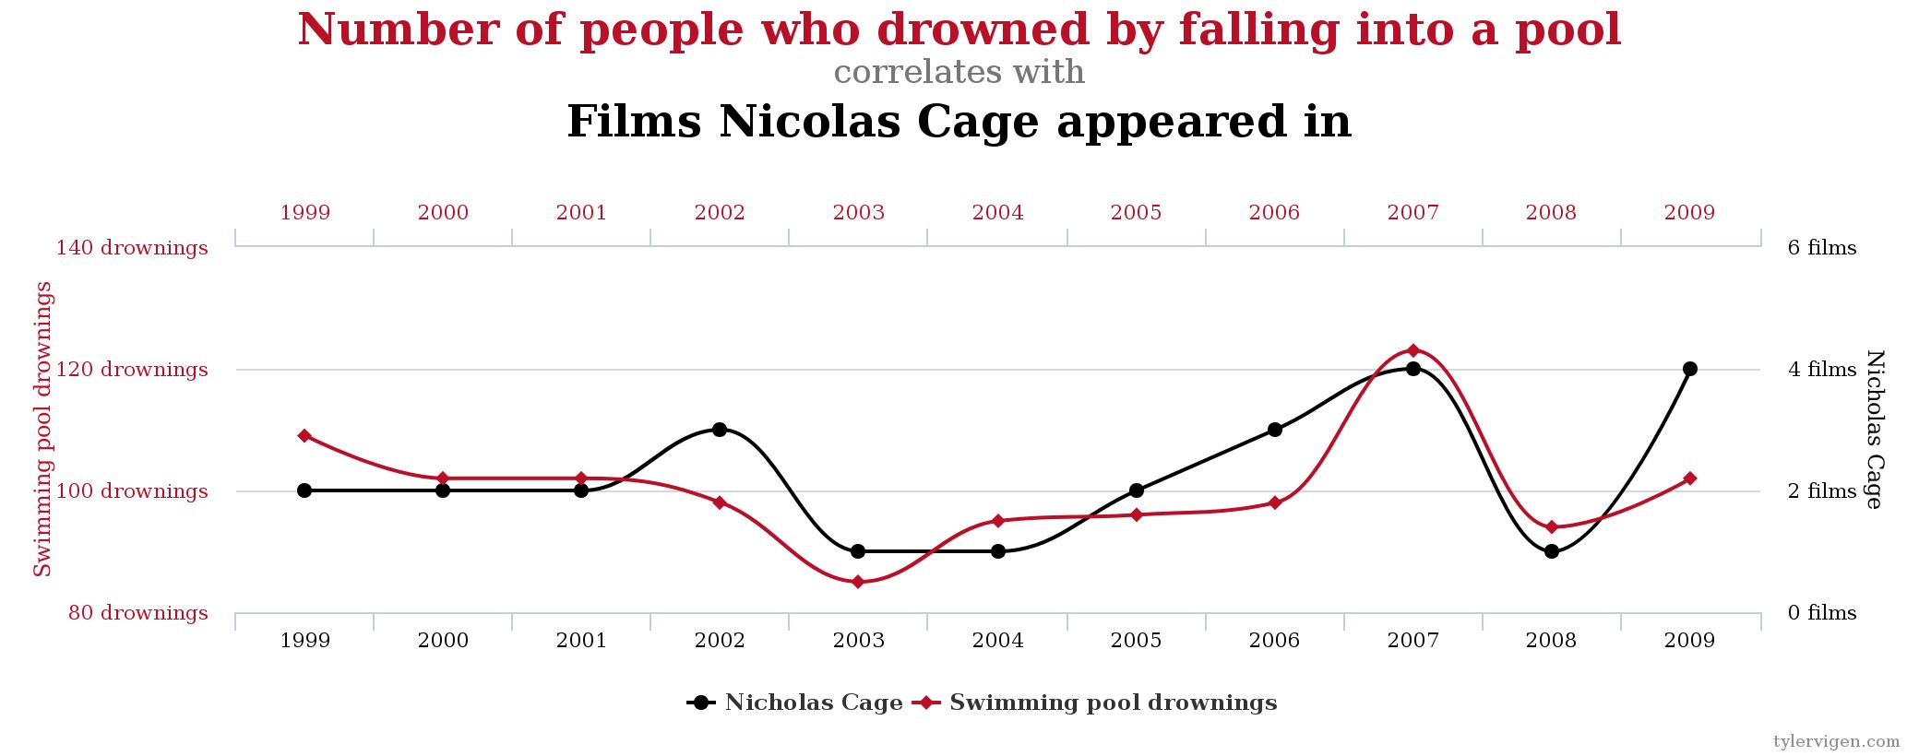
Spurious Correlations
r = .666

Slide 31
Correlations are not ideal… BUT
They allow for predicting a future outcome
  Can number of previous car accidents predict a future accident?
Allow for behavioral measurement where it might not be ethical to manipulate a variable
  Is obesity related to colon cancer? You cannot assign people to being obese vs. non-obese
Can determine whether there is a relationship between two variables and whether they are worth researching further

Slide 32
Experimental Designs
Experiments involve carefully controlled procedures in which one or more variables are manipulated
  Can infer causation/can explain WHY one variable affects another!
  Result is due to the manipulation!

Slide 33
Simple Experiments
Simplest experiment contains 2 groups:
  Group that receives the treatment (e.g., experimental drug)
  Group that receives a placebo (e.g., control group)
  Is there a difference between the two groups? If yes, what’s the direction?

Slide 34
Quasi-Experimental Variables
Not all variables can technically be manipulated
Gender/Sex/Race/Income/Health/Age: Cannot be directly manipulated and are therefore quasi-experimental variables
AGE is a particularly special quasi-experimental variable

Slide 35
The Time Dimension
Cross-Sectional Study – A study based on observations representing a single point in time, a cross section of a population.

Slide 36
Cross-Sectional Example
John
Mary
Jim
IQ Assessed
In 2016
Verbal
IQ
June
Mike
Ellen
Young
Old
Age

Slide 37
Cross-Sectional Design Limitations
Cross-sectional designs are susceptible to cohort effects
  Differences could be due to differing generations
Cross-sectional designs do not measure change
  Cannot determine how individuals may have changed from Time 1 to Time 2, Time 2 to Time 3, or beyond

Slide 38
The Time Dimension
Longitudinal Study – A study design involving the collection of data at different points in time.
  Trend Study – A study in which a given characteristic of some population is monitored over time.
  Cohort Study – A study in which some specific subpopulation, or cohort, is studied over time.

Slide 39
Longitudinal Example
John
Mary
Jim
John
Mary
Jim
Verbal
IQ
John
Mary
Jim
1960
Young
1980
Middle-aged
2000
Old
Age

Slide 40
Issues with Longitudinal Designs
Expensive!
  15-20 + years worth of data is expensive to collect
    Contact participants, follow them through life changes
Time!
  Takes much longer to collect data
Obsolescence!
  Testing procedures evolve, tests change (e.g., IQ)
    Use dated tests? Or new ones? Comparison issues?

Slide 41
Reminders/What’s next
IRB Application (Due 3/20)
Proposal Write up (Due 4/21)
What should you be doing right now???
  Developing your research question!
  Looking for sources (you need five peer reviewed sources!)

